Slide 1
FAKE NEWS PROJECT
SUBMITTED BY
ANJANA.P

Slide 2
CONTENT
Problem Statement
Data Review
EDA Analysis
Visualizations
Steps and Assumptions
Model Dashboard
Conclusions

Slide 3
PROBLEM STATEMENT
Several public concerns have arrived about the reach and effects of false information spread which acquires a tremendous potential to cause real world impacts.
In todays world spurious news articles can cause panic and create chaos in our societies
The yello journals and the websites are aware that people would be blindly attracted towards catchy titles and images
We are given a dataset which contains both real and fake news collected from online sites.
We have to test various models and select a best model to predict the genuinity of the news.

Slide 4
DATA REVIEW
We are given a csv file which contains some news with corresponding labels which shows whether news is real or flake.
There are 6 columns and 20800 rows
There are presence of null values.
Output column is label in which 0 represents real news and 1 represents fake news.
We have to test various models and select the more accurate one to predict whether the news is fake or not fake..

Slide 5
EDA ANALYSIS
There are 6 columns and 20800 rows.
Null values of news column are filled with corresponding headlines and viceversa.
All punctuations and stopwords are removed.
New columns are added to see the original length of news and length after cleaning.
Wordcloud library is used to see the most frequent words appeared in both fake and real news

Slide 6
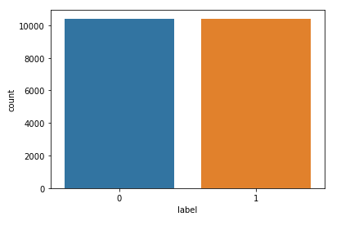
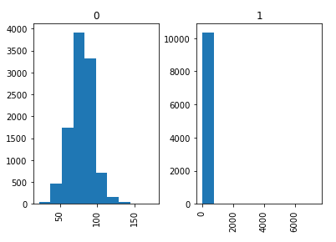
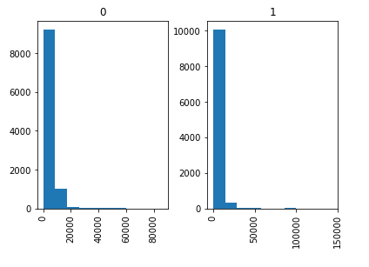
VISUALIZATIONS

Slide 7

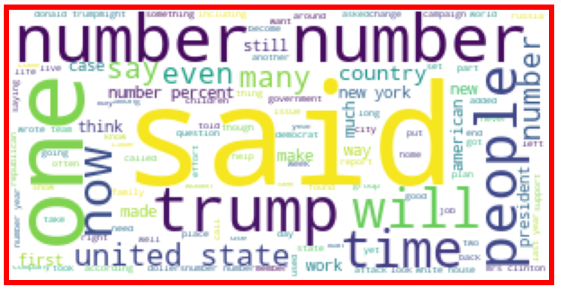

Slide 8
STEPS AND ASSUMPTIONS
After removing punctuations and stop words Tf-idf vectoriser is used to convert the text into machine learning algorithm format.
Train test split is done and various models like logistic regression, multinomial NB, Randomforest classifier, decision tree classifier, auc_roc score are found and the best model is saved as pickle file.
Accuracy score of various models are:
Logistic Regression-0.94
Random forest classifier-0.86
Multinomial NB-0.84
Decision tree classifier-0.89
Auc_roc score-0.94
Logistic regression gives maximum accuracy so it is selected as our model and saved in pickle format

Slide 9
CONCLUSION
Natural Language Process method is used to solve this problem.
The data is cleaned, preprocessed and tested various models and best model which gives maximum accuracy is selected
The detection of fake news has become more challenging as social media continues to dominate our every day lives
It is more challenging to detect it simply because of how attractive most fake news articles are titled.
With the help of artificial intelligence, we can control and limit the spread of such misinformation more quickly and efficiently as compared to manual efforts.

